Slide 1

Remote attacks and backdoors
Julian Keller Ben Eavenson Tyler Higgins Austin Cari

Slide 2
Topics of research
In the group proposal, we suggested multiple vulnerabilities that we were interested in learning about. The main topics include:
Shellshock: Although not in our original proposal, this was a vulnerability that we were able to recreate and would be able to use to create a reverse shell on our target’s computer. This vulnerability is unique to GNU bash and was present from V1.1 to V4.3.
Captive Portal: In combination with packet sniffing, One common way to infect devices over a network is to direct users to a captive portal before letting them browse freely. Many people overlook these agreements or warnings and click away. We created a webpage to be able to download our payload onto a victim’s device.
Packet Sniffing/Man-in-the-middle: Using a raspberry pi, we are able to broadcast a wi-fi signal that other devices can connect to, allowing their traffic to travel through our raspberry pi before it finally goes off to it’s destination.

Slide 3
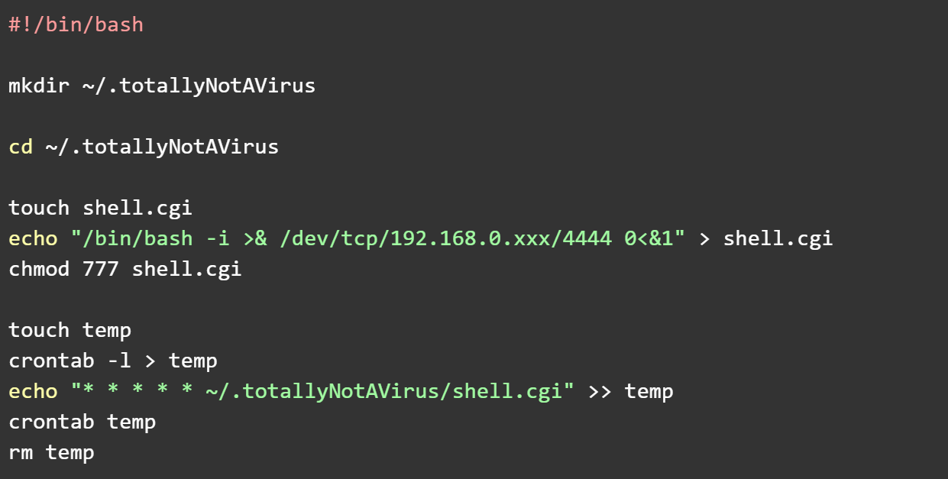
Using shellshock to start a reverse shell

Slide 4
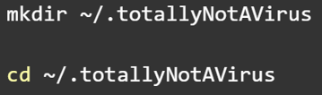
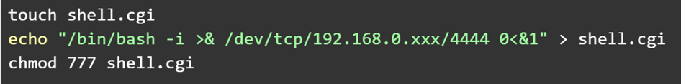
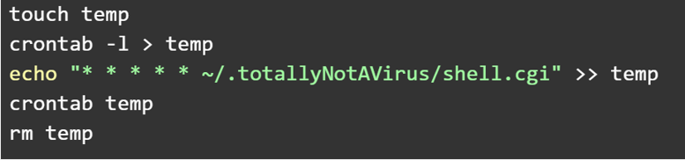
A little explanation
Step 1:
Create a hidden directory and change the cwd there
Create the payload file shell.cgi. Echo the payload and redirect the output to shell.cgi. Give it all permissions.
Step 2:
Create a file and store crontab syntax there to execute the payload every minute. Then execute crontab with that file as input. rm the file when you’re done with it
Step 3:

Slide 5
Captive Portal
Social engineering approach to infiltrating a device. Rely on the impatience and ignorance of users to click on untrusted links and buttons.
This approach is used in combination with attacks like a man-in-the-middle attack. When a device wants to reach an IP address like 192.168.0.1, the attacker can redirect traffic to their own locally hosted webpage instead.
This is an effective approach because if traffic is managed carefully enough, the victim will not even realize that their device has become compromised. If they try to use a login prompt and enter another webpage, the attacker can log their keystrokes, stealing their credentials, and still redirect them to their desired page with ease.

Slide 6
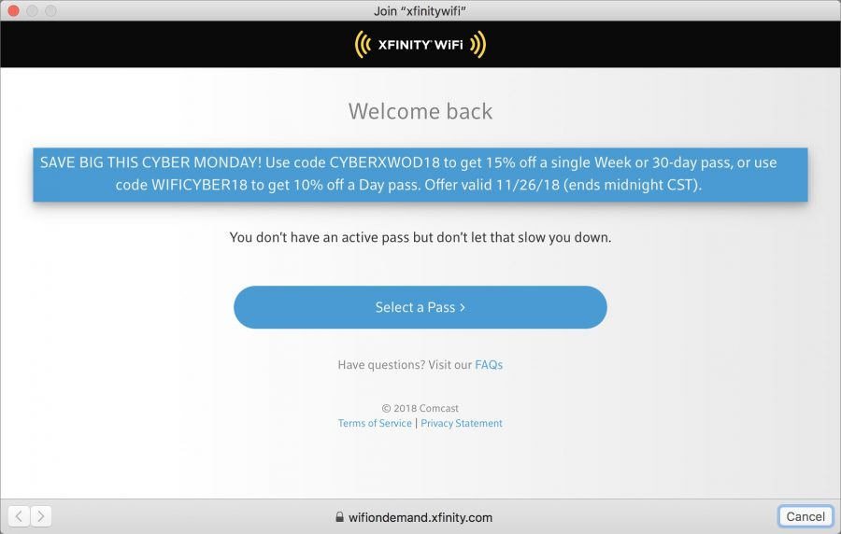
Example
Many attackers impersonate real companies and corporations.
The kind of information that attackers are looking for are credit card numbers, email addresses, login credentials, social security numbers, phone numbers, home addresses, birthdays, or other identifying information that could be abused.

Slide 7
Protecting yourself
https://www.cnet.com/news/five-ways-to-protect-yourself-from-wi-fi-honeypots/#!
1. Turn off Wi-Fi capabilities when you’re not using them
2. Avoid open Wi-Fi networks
Anyone can connect to these networks. They are unmonitored and no one is watching.
3. Use a VPN
4. Do not leave obsolete devices connected to networks
The weakest link in a network is an entry point that can be exploited for easy access to other devices
5. Change your passwords often
Keep 3-5 unique passwords or similar variants of 2-3 passwords
6. Don’t click on suspicious links

Slide 8
Tools and Technologies used
Creating and interacting with our backdoor payload
Netcat
GNU Bash
Creating captive portals
TCP/IP packets/connections
JavaScript/HTML
Raspberry Pi 4

